Slide 1
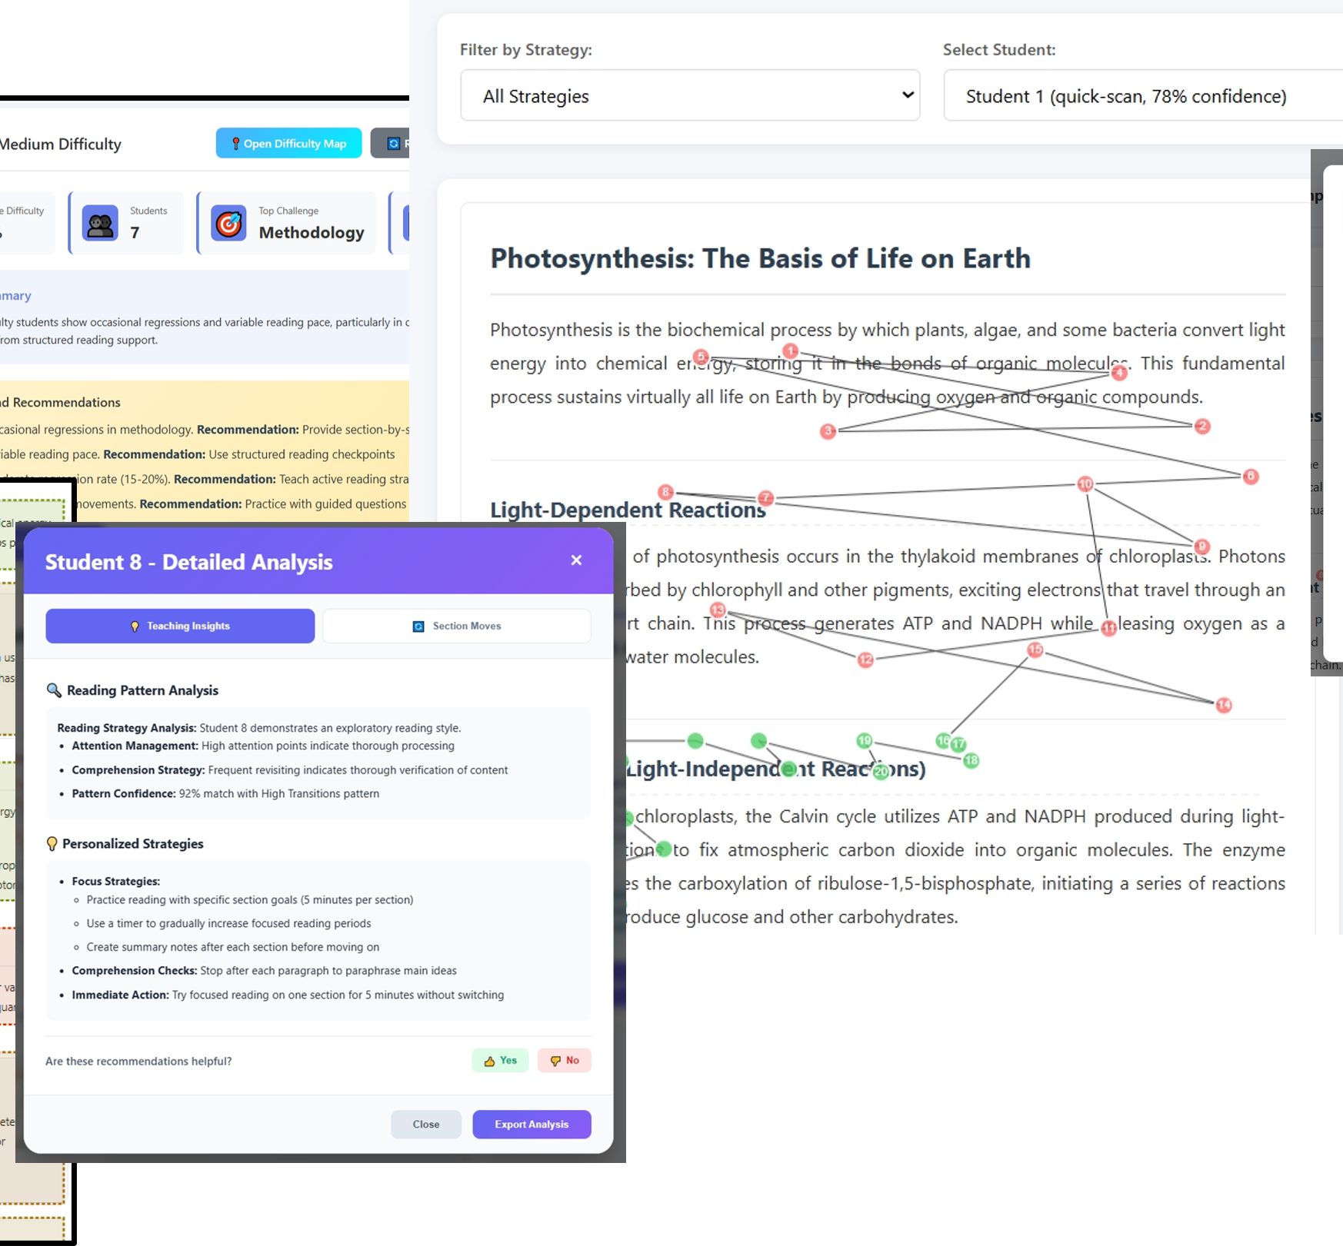







Aligning AI-Assisted Multimodal Learning Analytics Dashboards with Instructional Strategies for Reading
Konstantinos Tsiakas, Open Universiteit, The Netherlands, konstantinos.tsiakas@ou.nl
Francesca Zermiani, University of Valencia, Spain, francesca.zermiani@uv.es
Milos Kravcik, German Research Center for Artificial Intelligence, DFKI, milos.kravcik@dfki.de
Roland Klemke, Open Universiteit, The Netherlands, roland.klemke@ou.nl
Notes:
To replace the image: Right click on it > Replace image > Upload from computer > Select the image you want > Open
You can also resize the new image by double clicking on it.

Slide 2

Agenda
9:30 – 11:00
Introduction and Presentation of Use Cases and Frameworks
Introduction to Design Activity Tool
11:00 – 11:30
Coffee Break
11:30 – 13:00
Design Activity (cont’d)
Discussion and Closing

Slide 3
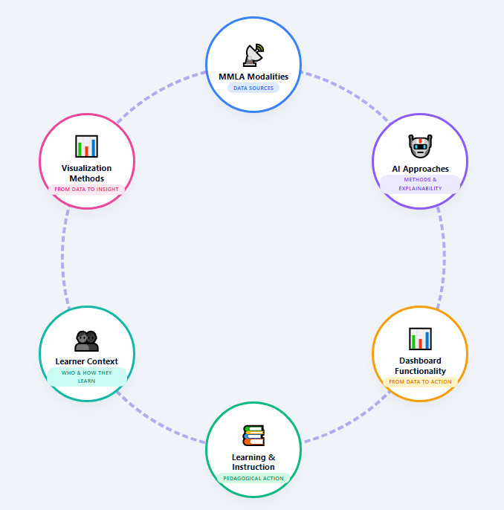
Goal
How can multimodal learning analytics and AI methods be translated into dashboards that are not merely technically sophisticated, but pedagogically meaningful and actionable for teachers and reading-related tasks?

Slide 4
Goal
How can multimodal learning analytics and AI methods be translated into dashboards that are not merely technically sophisticated, but pedagogically meaningful and actionable for teachers and reading-related tasks?
explore the connection between
MMLA & AI methods
dashboard design features
reading instructional strategies

Slide 5
Short Introduction

Slide 6
Overview
Notes:
To replace the image: Right click on it > Replace image > Upload from computer > Select the image you want > Open
You can also resize the new image by double clicking on it.

Slide 7
Why is reading hard to assess?
Reading comprehension is a multi-component construct that single scores cannot capture
Reading comprehension depends on a complex interplay of reader, text, and task factors, and its assessment requires a profile of skills
Kwiatkowska-White, B. (2012). Understanding reading comprehension performance in high school students
Groot, N. (2023). Using Task Features to Predict Item Difficulty and Item Discrimination in 3F Dutch Reading Comprehension Exams

Slide 8
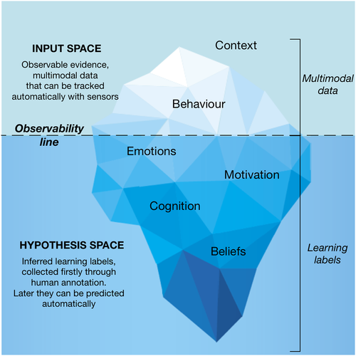
Multimodal Learning Analytics
Input Space (Observable): This includes data that sensors can directly capture, such as learner behavior, activity, and contextual information.
Hypothesis Space (Unobservable): This covers latent attributes like cognition, metacognition, and emotions, which sensors cannot directly observe and require human-driven interpretation
Di Mitri, D., Schneider, J., Specht, M., & Drachsler, H. (2018). From signals to knowledge: A conceptual model for multimodal learning analytics. Journal of Computer Assisted Learning, 34(4), 338-349.

Slide 9
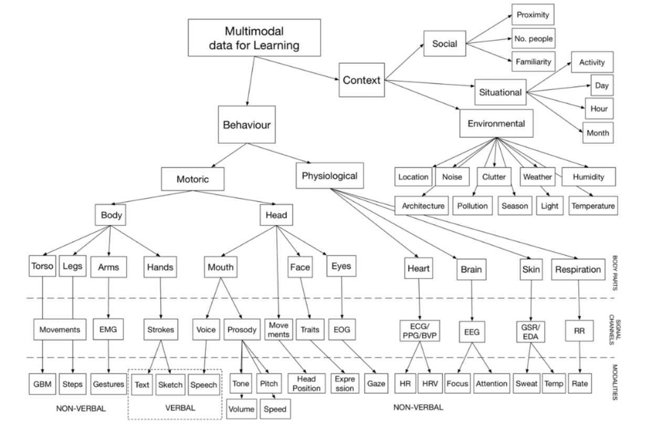
Di Mitri, D., Schneider, J., Specht, M., & Drachsler, H. (2018). From signals to knowledge: A conceptual model for multimodal learning analytics. Journal of Computer Assisted Learning, 34(4), 338-349.

Slide 10
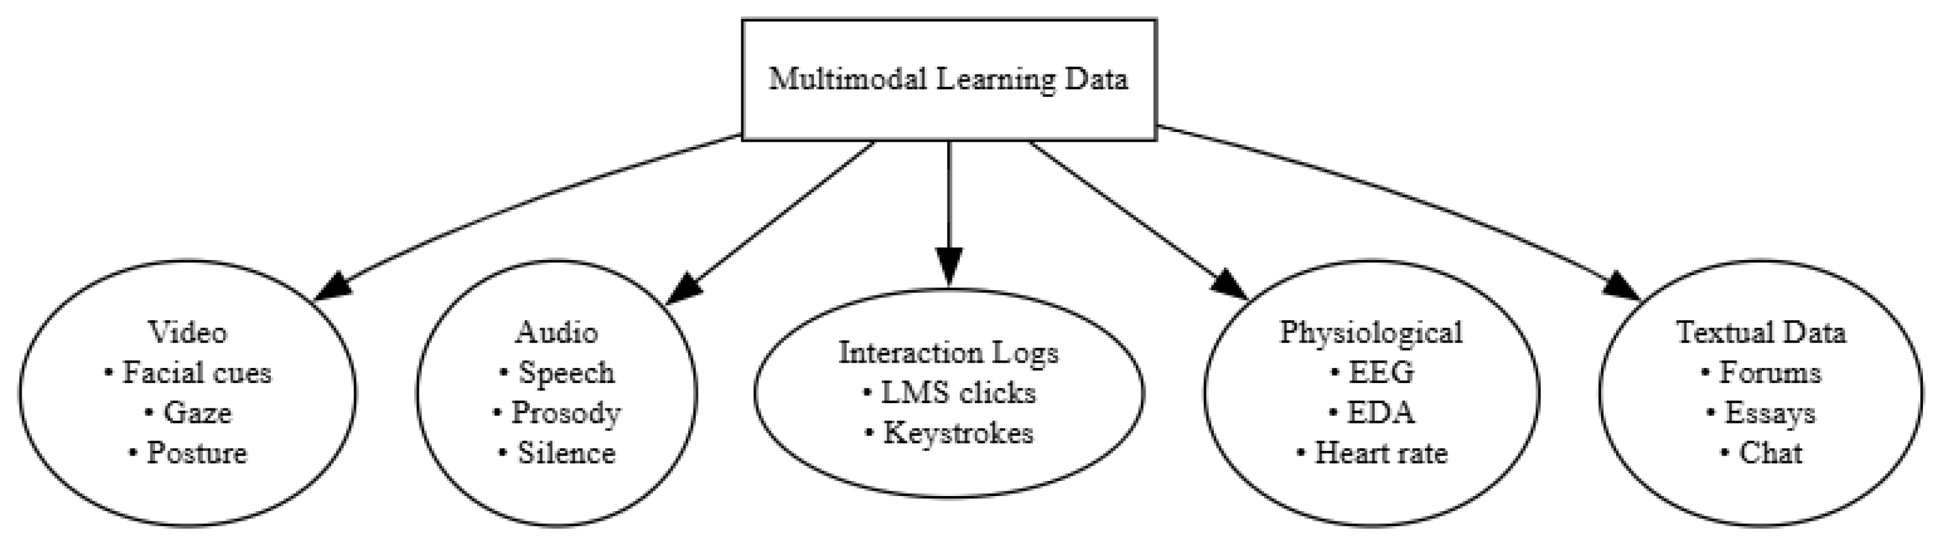
Multimodal Learning Analytics
Georgios, K., Sotiris, K., Theodor, P., & Achilles, K. (2026). A Survey of Multimodal Learning Analytics: Data, Methods, Systems, and Responsible Deployment. Future Internet, 18(3), 115.
Notes:
To replace the image: Right click on it > Replace image > Upload from computer > Select the image you want > Open
You can also resize the new image by double clicking on it.

Slide 11
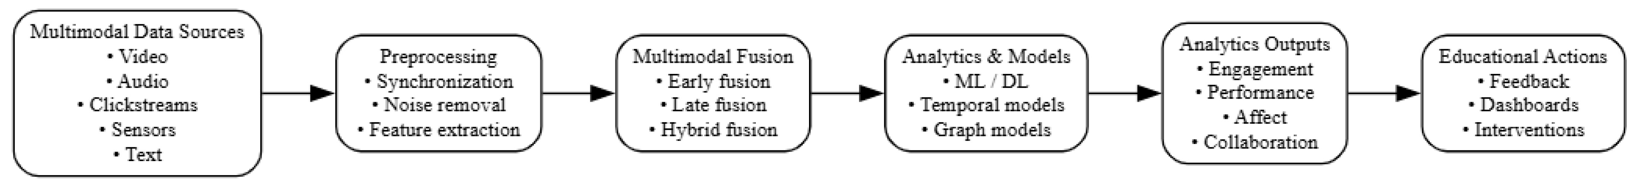
AI and Multimodal Learning Analytics
Georgios, K., Sotiris, K., Theodor, P., & Achilles, K. (2026). A Survey of Multimodal Learning Analytics: Data, Methods, Systems, and Responsible Deployment. Future Internet, 18(3), 115.
Notes:
To replace the image: Right click on it > Replace image > Upload from computer > Select the image you want > Open
You can also resize the new image by double clicking on it.

Slide 12
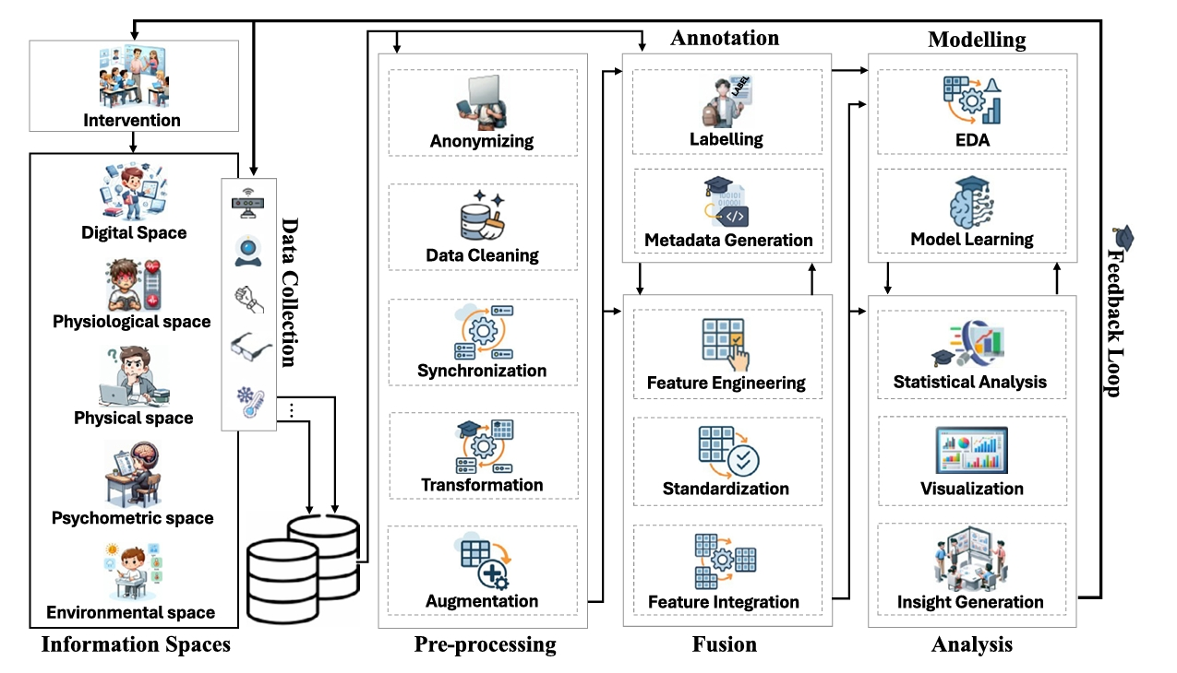
AI and Multimodal Learning Analytics
Mohammadi, M., Tajik, E., Martinez-Maldonado, R., Sadiq, S., Tomaszewski, W., & Khosravi, H. (2025). Artificial intelligence in multimodal learning analytics: A systematic literature review. Computers and Education: Artificial Intelligence, 8, 100426.
Notes:
To replace the image: Right click on it > Replace image > Upload from computer > Select the image you want > Open
You can also resize the new image by double clicking on it.

Slide 13
Dashboard Functionalities and Level of Support
Dashboard Type | Function | Level of Support
Mirroring | Simply visualizes data about student activity (e.g., participation, progress) without interpretation. | Low – Teacher must detect and interpret issues independently.
Alerting | Automatically flags specific critical events or problems (e.g., a group is stuck). | Medium – Aids detection but not interpretation.
Advising | Provides alerts plus suggestions or recommendations for pedagogical action (e.g., "Provide additional instruction on this rule"). | High – Aids both detection and interpretation.
Soller, A., Martinez, A., Jermann, P., & Muehlenbrock, M. (2005). From mirroring to guiding: A review of state of the art technology for supporting collaborative learning. International Journal of Artificial Intelligence in Education, 15(4), 261-290.

Slide 14
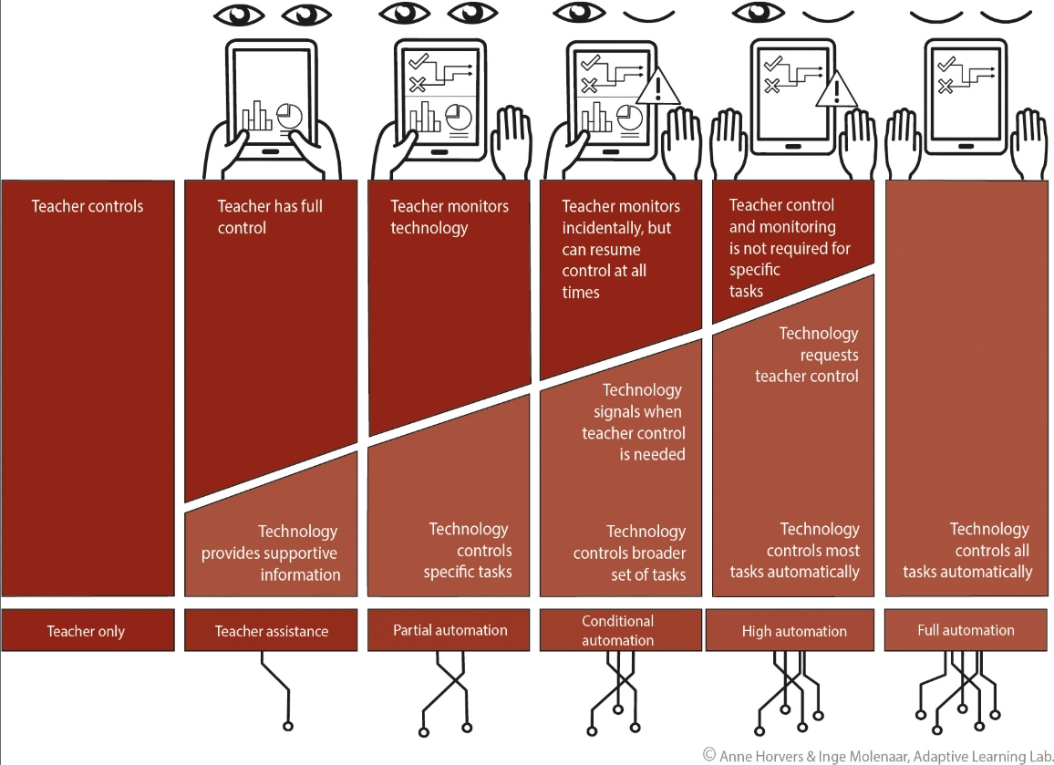
Levels of Automation
Molenaar, I. (2022). Towards hybrid human‐AI learning technologies. European Journal of Education, 57(4), 632-645.
Notes:
To replace the image: Right click on it > Replace image > Upload from computer > Select the image you want > Open
You can also resize the new image by double clicking on it.

Slide 15
Goal of the Workshop
explore the connection between
MMLA & AI methods
dashboard design features
reading instructional strategies

Slide 16

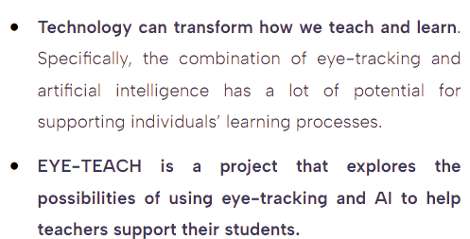








What is EYE-TEACH? https://eyeteach.eu/

Slide 17
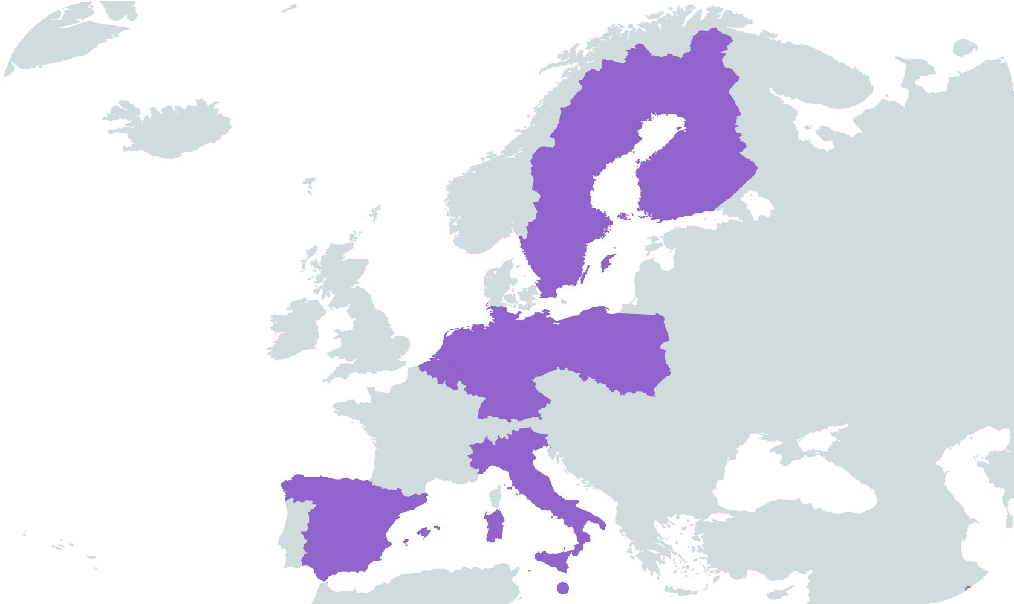
Who is involved in EYE-TEACH?
Research project located in 9 European countries and funded by the European Union’s Horizon Europe Programme.
Project team includes researchers, practitioners and developers in the ﬁelds of education, psychology, educational technology, artiﬁcial intelligence, ethics, and communication.

Slide 18
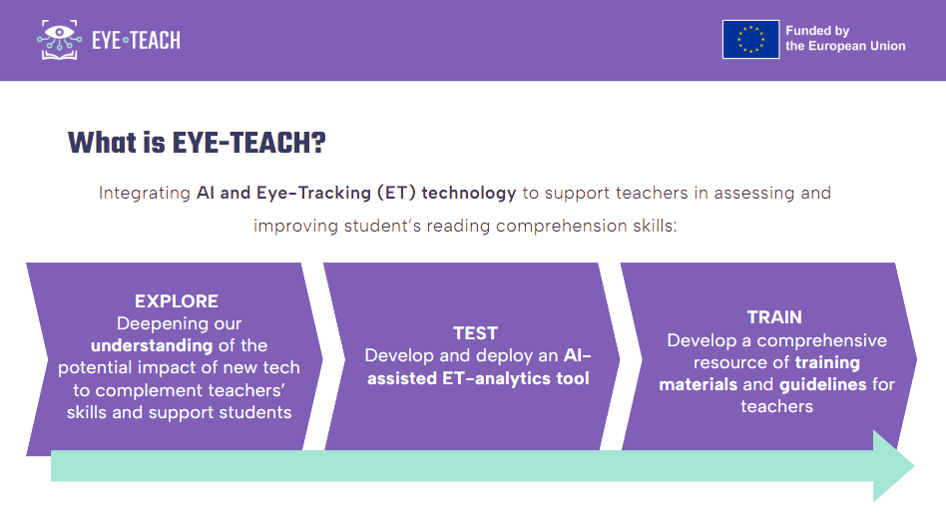

Slide 19
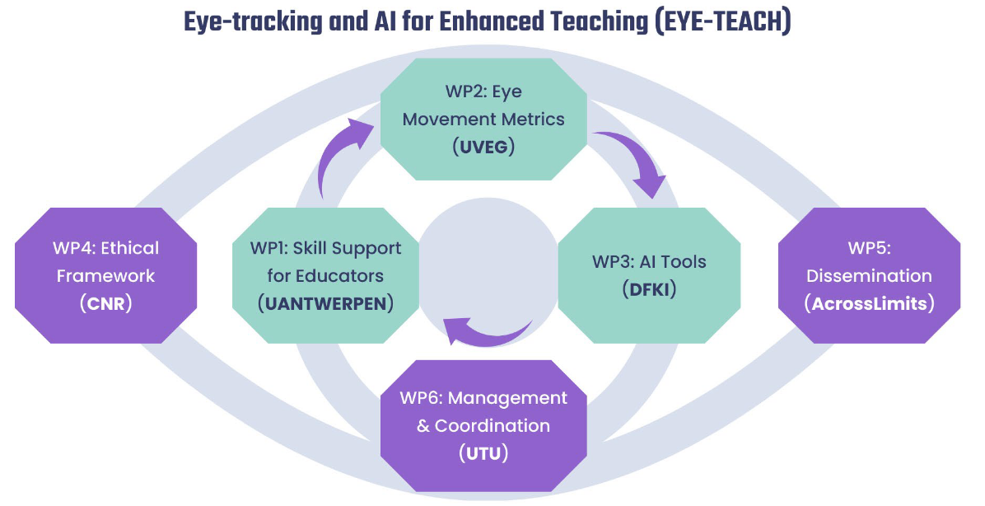

Slide 20
Use Cases
Notes:
To replace the image: Right click on it > Replace image > Upload from computer > Select the image you want > Open
You can also resize the new image by double clicking on it.

Slide 21
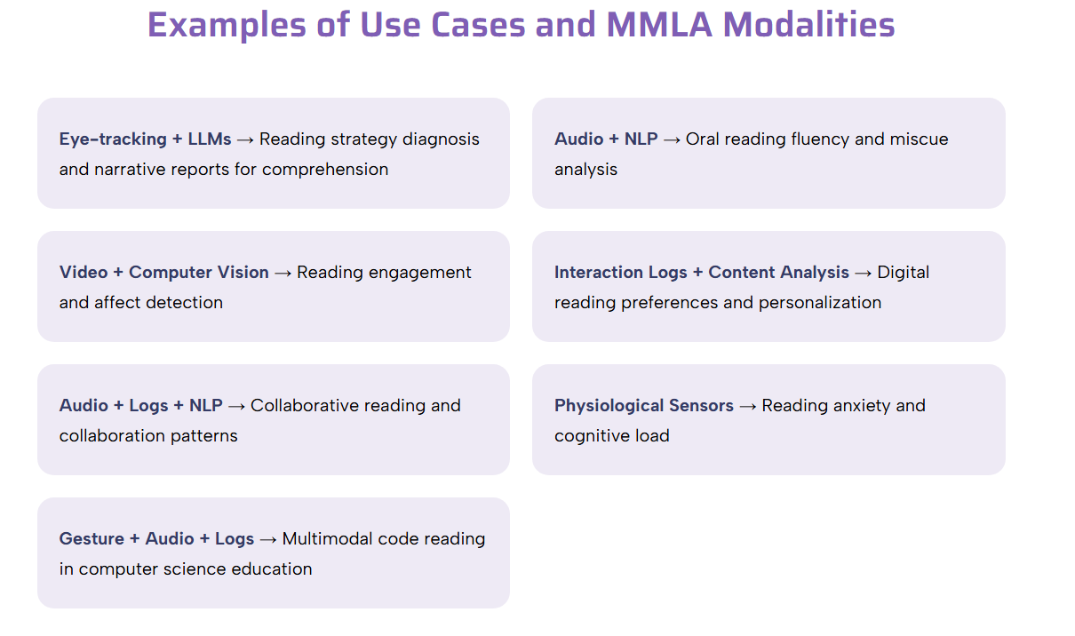
Notes:
To replace the image: Right click on it > Replace image > Upload from computer > Select the image you want > Open
You can also resize the new image by double clicking on it.

Slide 22



EYE-TEACH use case
Identify ET metrics which can predict reading comprehension
Analyze ET metrics to predict reading comprehension processes
Translate gaze patterns and AI outputs into actionable insights

Slide 23
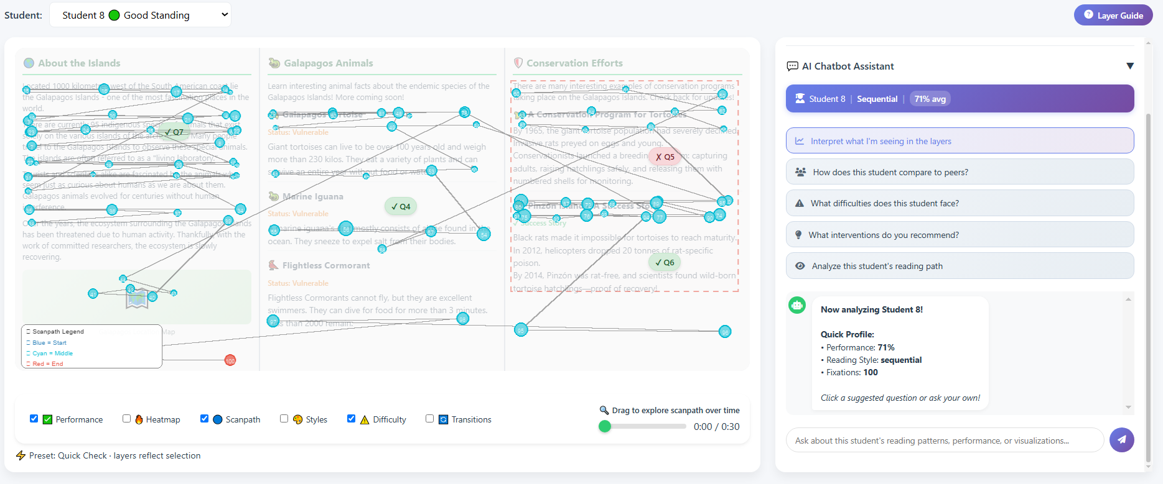
Notes:
To replace the image: Right click on it > Replace image > Upload from computer > Select the image you want > Open
You can also resize the new image by double clicking on it.

Slide 24
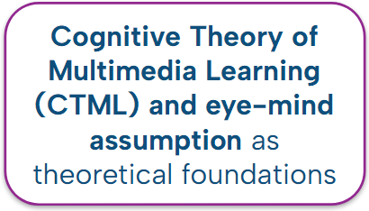
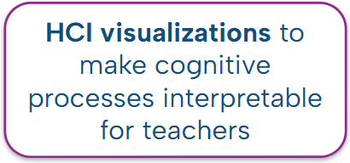
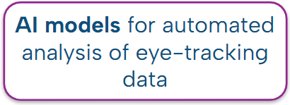
AI Eye-tracking in MML (Tsiakas et al., 2026)
Notes:
To replace the image: Right click on it > Replace image > Upload from computer > Select the image you want > Open
You can also resize the new image by double clicking on it.

Slide 25
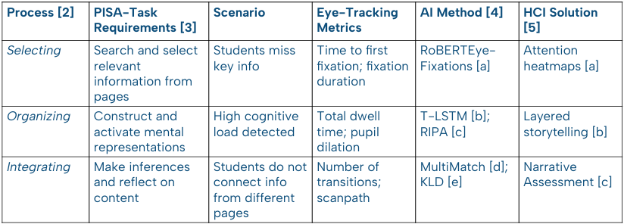
Mapping AI/HCI Eye-tracking in MML (Tsiakas et al., 2026)
Notes:
Francesca

Slide 26
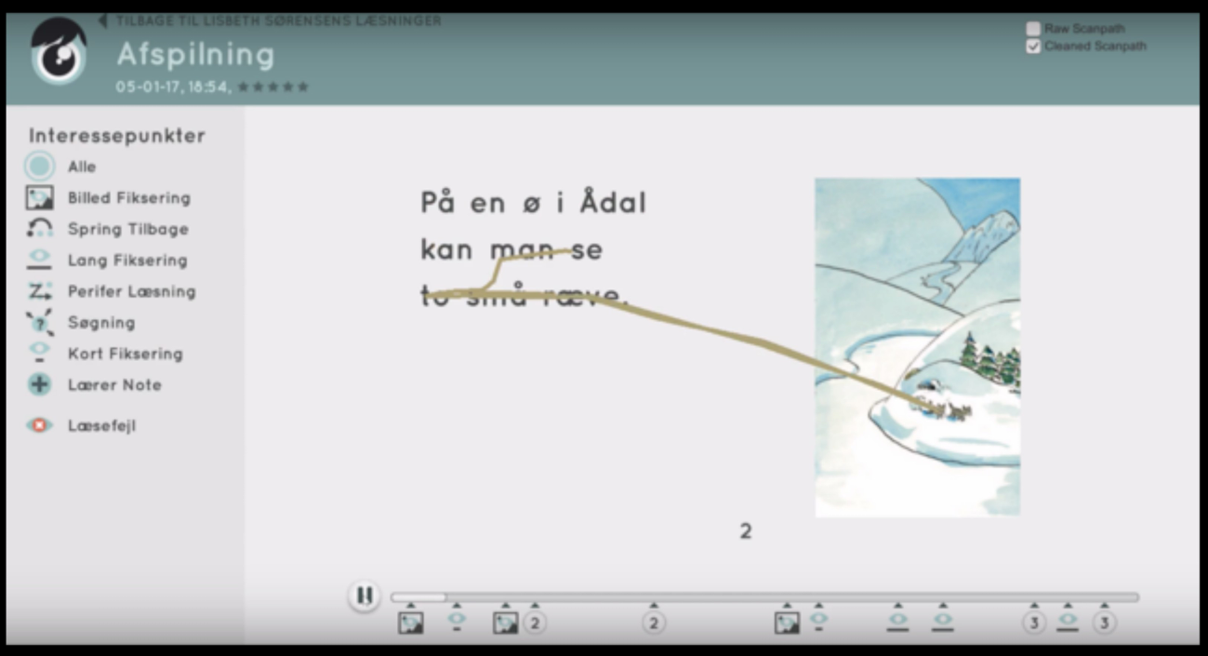

Data-driven reading education (EyeJustRead)
EyeJustRead
Notes:
Francesca. EyeJustRead is a digital reading platform that uses eye tracking and read-aloud data to capture and analyze readers’ reading behavior, providing educators with measures of reading speed, gaze patterns, and reading errors.

Slide 27
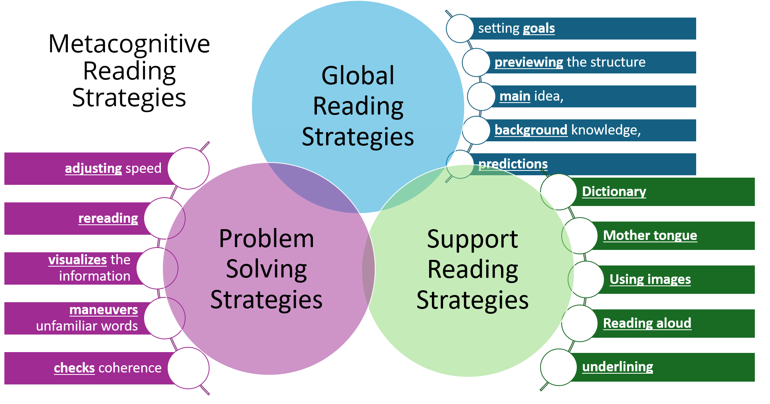

Metacognitive Strategy Instruction and Reading Behaviour: Eye-Tracking Evidence from L2 University Students
Mhd Ghaith Alturjman
Eötvös Loránd University
Notes:
To replace the image: Right click on it > Replace image > Upload from computer > Select the image you want > Open
You can also resize the new image by double clicking on it.

Slide 28
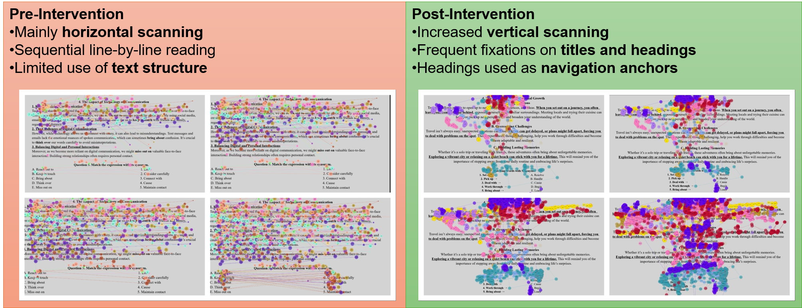
Metacognitive Strategy Instruction and Reading Behaviour: Eye-Tracking Evidence from L2 University Students
Notes:
To replace the image: Right click on it > Replace image > Upload from computer > Select the image you want > Open
You can also resize the new image by double clicking on it.

Slide 29
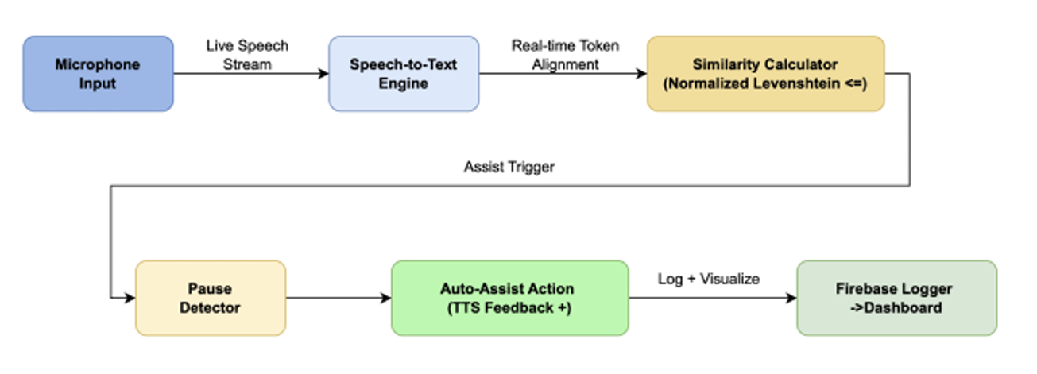
AI-powered Reading Assistance in Dyslexic Students
Skandana, K. V., Supreetha, R., Shreya, U., & KS, A. K. (2026, April). DyslexiAid: An AI-Powered Multimodal Learning Platform for Real-Time Reading Assistance in Dyslexic Students. In 2026 4th International Conference on Knowledge Engineering and Communication Systems (ICKECS) (pp. 1-6). IEEE.
Notes:
To replace the image: Right click on it > Replace image > Upload from computer > Select the image you want > Open
You can also resize the new image by double clicking on it.

Slide 30
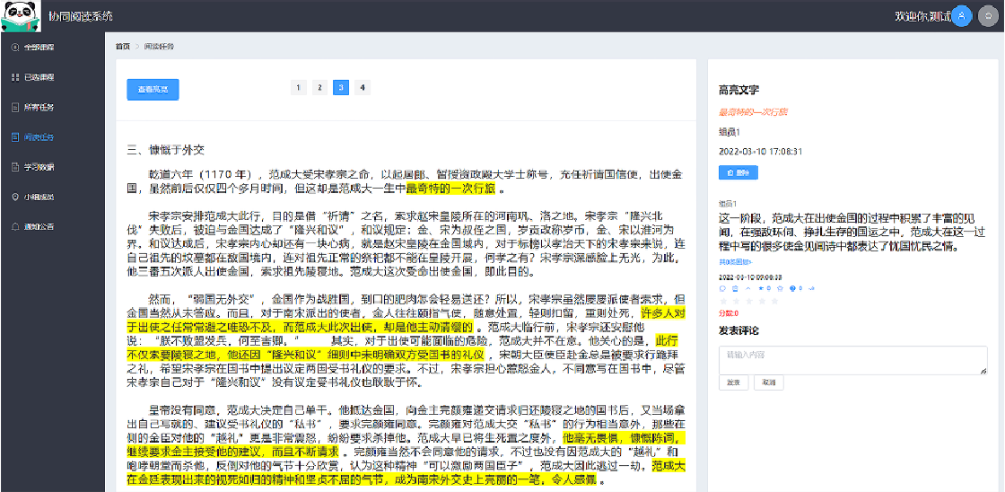
Collaborative Reading Annotation
Liu, L., Zhang, L., Shu, Y., Wang, S., Wu, H., & Xv, M. (2023, April). Evaluation of a collaborative reading annotation system through multimodal data analysis. In Extended Abstracts of the 2023 CHI Conference on Human Factors in Computing Systems (pp. 1-6).
Notes:
To replace the image: Right click on it > Replace image > Upload from computer > Select the image you want > Open
You can also resize the new image by double clicking on it.

Slide 31
Design Activity
Design Activity · AIM²READ Workshop

Slide 32

Thank you for your attention
konstantinos.tsiakas@ou.nl
Funded by the European Union. Views and opinions expressed are however those of the author(s) only and do not necessarily reflect those of the European Union or the European Research Executive Agency (REA). Neither the European Union nor the granting authority can be held responsible for them.

